Slide 1
Thermal Measurements w/ Fan + Portable Charger
2/14/18

Slide 2
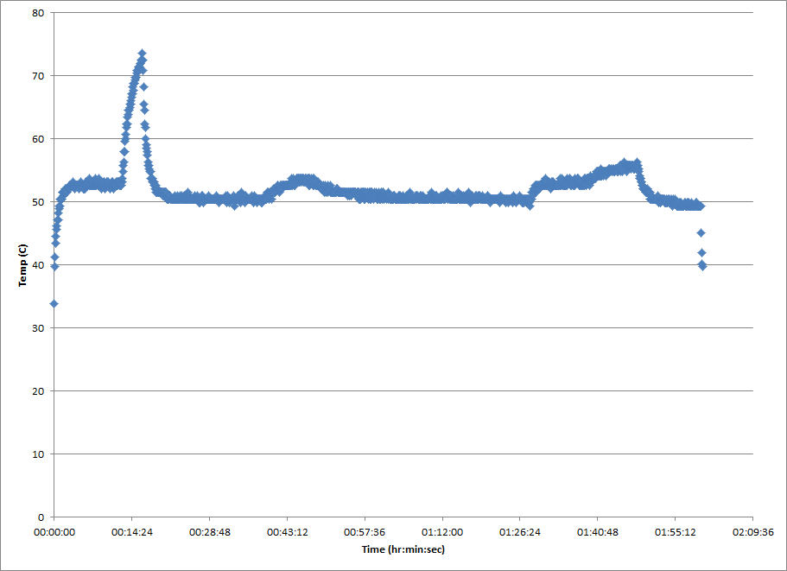
First 2 hour run powered by battery
The spikes on this run in temperature were related to fan angle
The spike around the 14min. mark had the fan pointed tangentially to the heatsink
Tail off at the end is after stress program met its 2 hour timeout

Slide 3
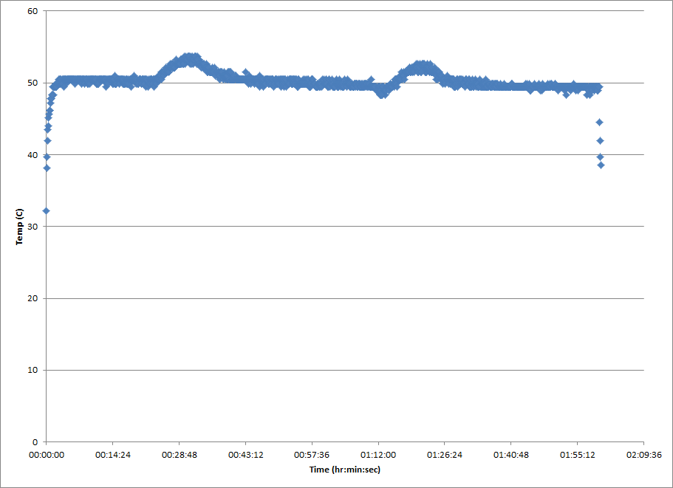
Second 2 hour run powered by battery
This run was done almost directly after the first run

Slide 4
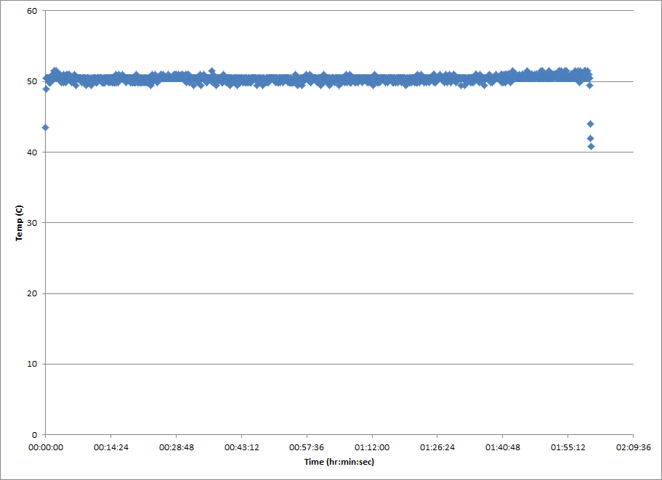
Third 2 hour run powered by battery
This run was done a few days later, battery pack wasn’t recharged at all

Slide 5
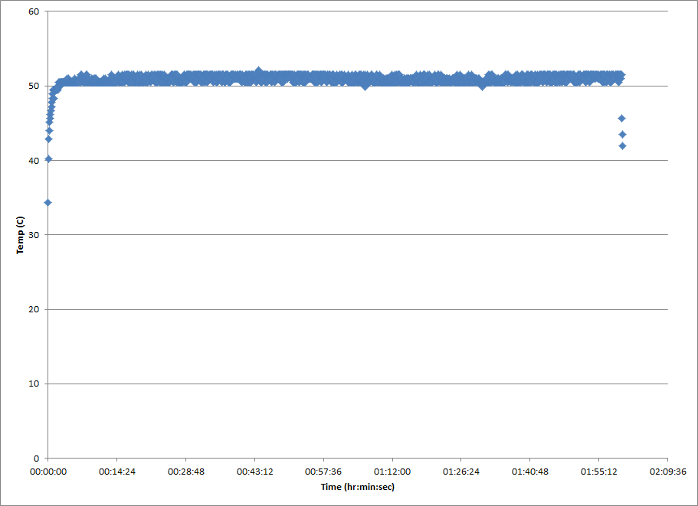
Fourth 2 hour run powered by battery
This run was done almost directly after the 3rd run

Slide 6
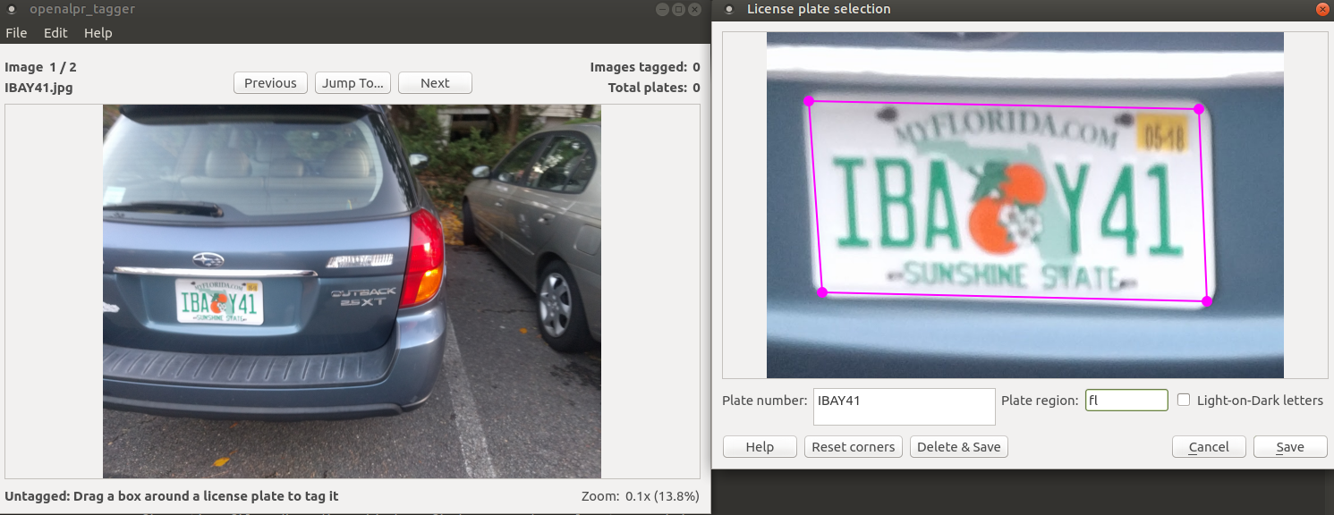
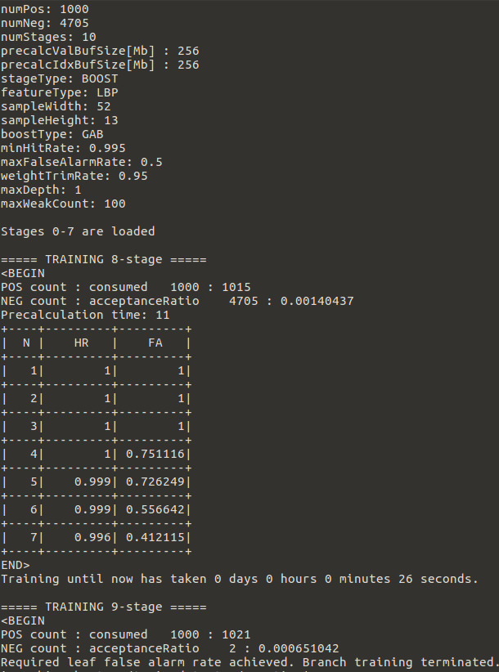
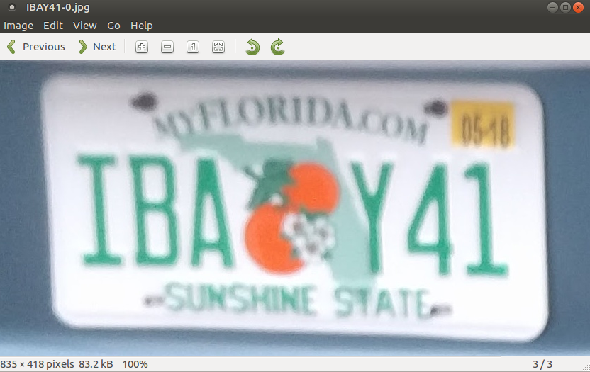
Manual plate tagging for plate cropping
Replacement of openALPR US XML
2000+ plates have been used to train openALPR; therefore 3000+ must be manually cropped and used for trto justify replacing the US XML

